Slide 1

Building Tips & Tricks
Patti Poston
Nevada FIRST Senior Mentor

Slide 2
FTC Kits
 | Actobotics | REV | Tetrix | Custom
Price for Starter Kit | $494 with team discount | $444 | $532 | ~$1,000
Starter Kit Quality | Best | Good | Okay | No Starter Kit
Robot can be built to precise specifications | Good | Great | Good | Best
Build Materials are easy to use and learn | Great | Great | Best | Okay
Robot is easy to customize | Great | Great | Okay | Best
Will need access to tools such as bandsaws to use system most effectively | Sometimes | Often | Sometimes | Almost Always
Overall Score | Great | Great | Good | Great Recommended for Veteran Teams only

Slide 3
Building Tips and Tricks
Do few things in rookie season but do them well (maybe just 1 thing)
Don’t start with 18” cube frame – allow for space
Mount electronics under chassis
COG
Speed vs. Torque
Learn Gear Ratio
Reliability, consistency, wiring

Slide 4
Building Tips and Tricks
Measure twice cut once
Design for easy repair
Drill access holes
Fasten nuts loosely
Protect wheels if possible
Use Wheel Guards
Protective bumper
Protect Wires

Slide 5
Building Tips and Tricks
Make connections and joints strong
Use enough screws
Avoid crooked construction
Manage ESD (Electro-Static Discharge)
Static Spray or dryer sheets
Mount electronics on nonconductive material
Protect Power/Kill Switch
Protect top of robot from game elements

Slide 6
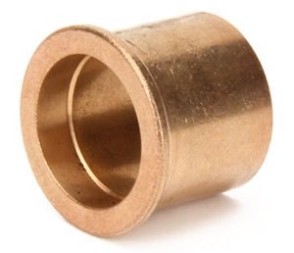
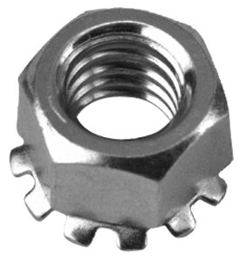
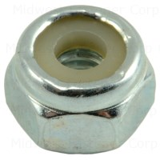
Build Tips and Tricks
Use Metal Offsets for support
Use Bronze Bushings for Axles
Rubber Bands for Springs
Use Nylocs for final design

Slide 7
Testing
Test each assembly
Test final robot
Test each modification
A small change can cause a big side-effect
Think about possible effects before making a change
Practice on field with game elements
Attend Scrimmages

Slide 8
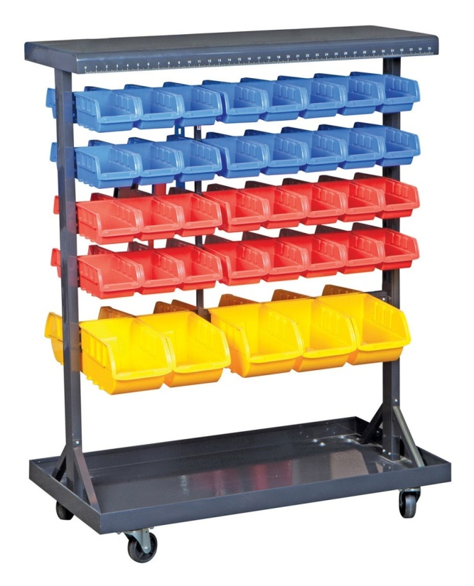
Tools and Workshop
Carpenter square plus a T-square
Tackle Boxes
Double-sided mobile rack
Loose part container
Testing/driving area

Slide 9
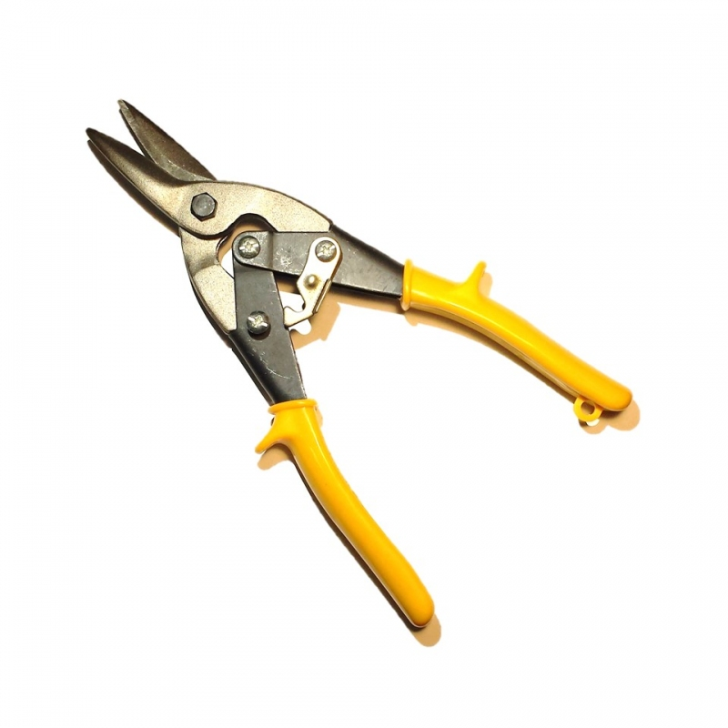
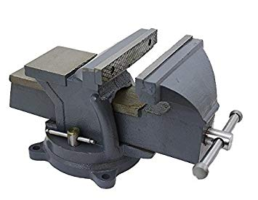
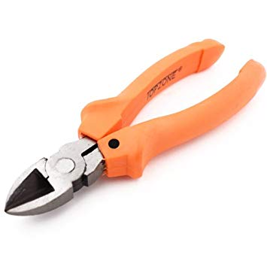
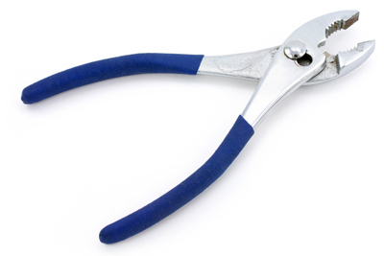
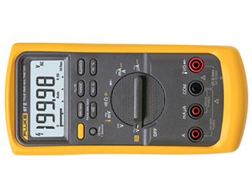
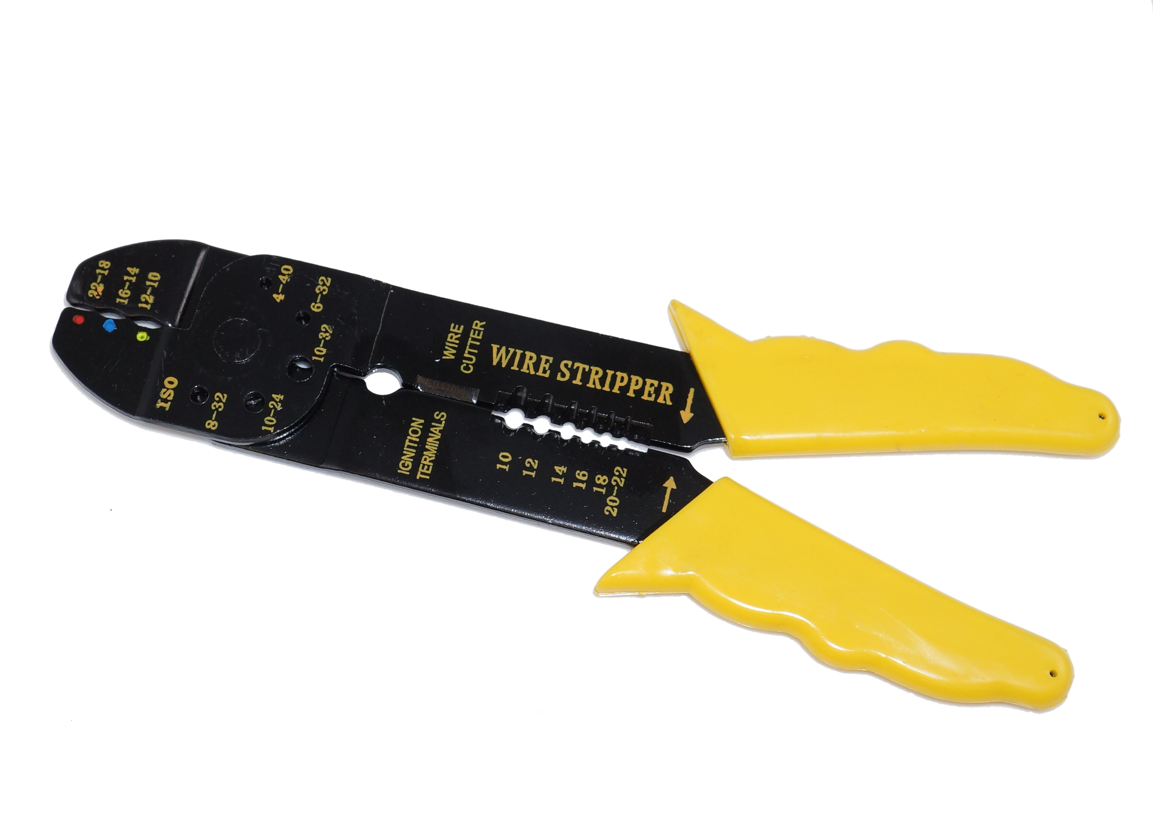
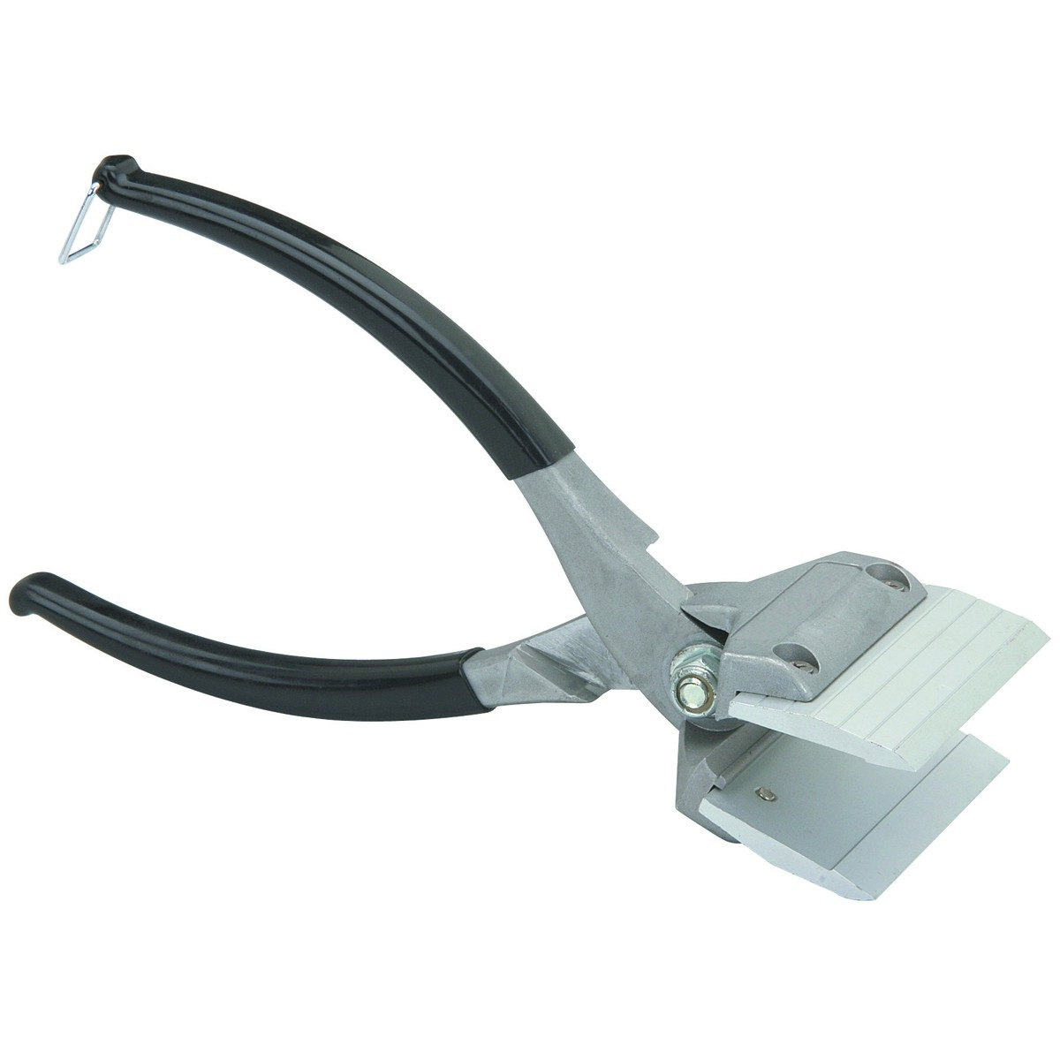
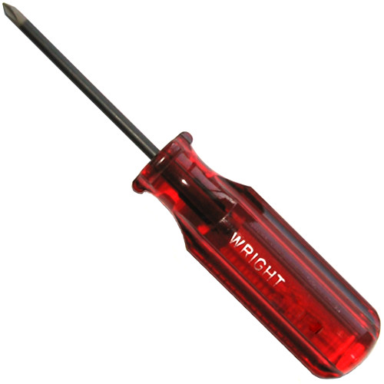
Suggested Tools
Tin Snips | Vise Clamp | Wire Cutter Pliers | Slip-joint Pliers
Wire Stripper | Multimeter | Metal Crimper | Phillips Screwdriver

Slide 10
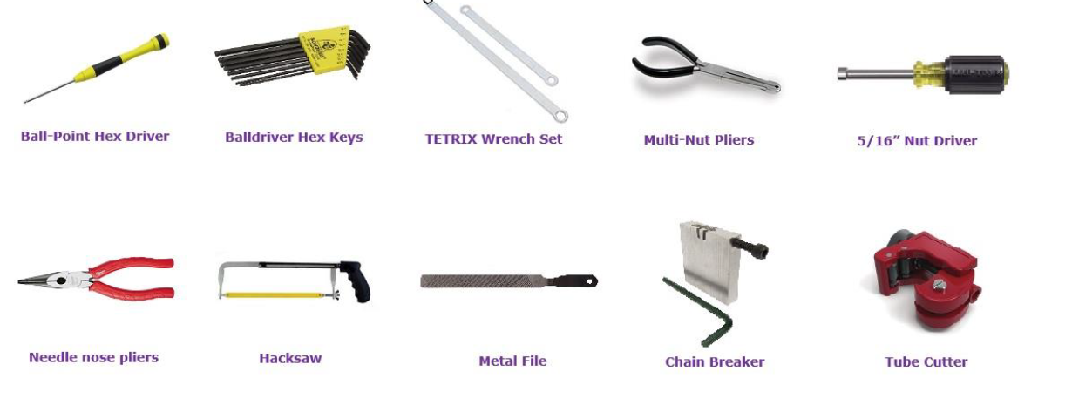
More Tools

Slide 11
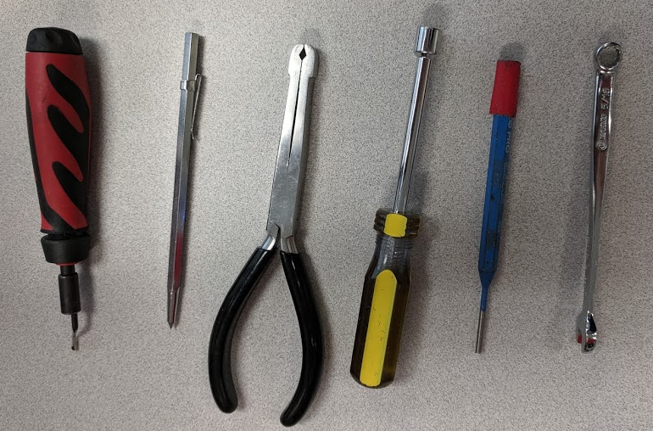
New Additions

Slide 12
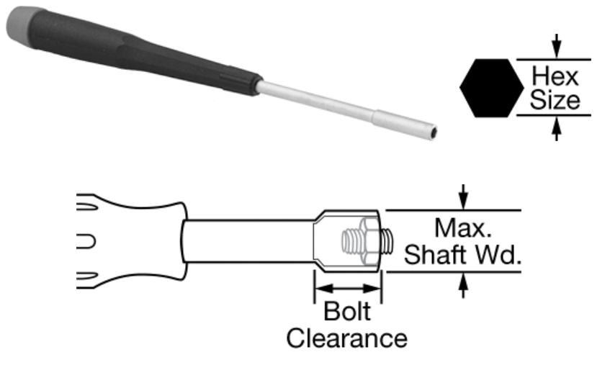
McMaster-Carr Nut Driver
Seem better than REV drivers
Notes:
The McMaster-Carr 5.5mm nut drivers seem better than the REV drivers; the REV drivers' sockets seem to run a bit large at times (5.7mm) and sometimes don't grab quite as well as the ones from McMaster-Carr.

Slide 13
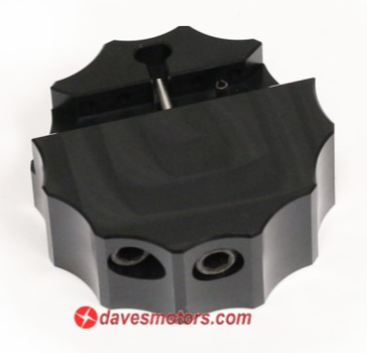
Chain Breaker #25
Dark Soul Chain Breaker
DarkSoul
Notes:
Many veteran FTC and FRC teams swear by the DarkSoul tool; they say to ignore all of the cheaper chain breakers and just spend the money to get this one. I agree. At the 2018 FIRST Community Conference the REV Robotics folks displayed their new chain breaker tool that looks like it could work as well or better than the DarkSoul one listed here; but there's no release date or pricing for the REV tool yet.

Slide 14
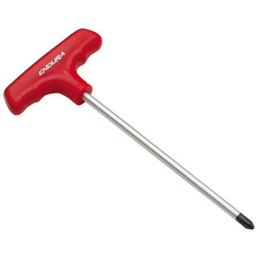
Advanced Tools
Electric Drill
Drill Press
Bench Grinder
Jigsaw
Rotary Tool (Dremel)
Band Saw
Magnetizer
T-handle Hex Keys in Tetrix sizes
T-handle 5/16” nut driver
5/16” open and closed end combo wrenches

Slide 15
Building Tools Links
Roboplex.org is dedicated to furthering competitive robotics. The site is a collaborative workspace where robotics groups can information.
FTC hardware, tools, and tips – From Roboplex Team

Slide 16
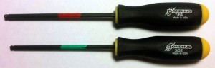
Mark Tools
Red= 7/64" (#6-32 socket cap screws)
Green = 3/32" (hub set screws)
Blue = 5/64" (button cap screws and TETRIX collars)
Orange = 5.5mm/1.5mm (REV Robotics screws / nuts / collars)
Notes:
Many Teams adopt a color convention

Slide 17
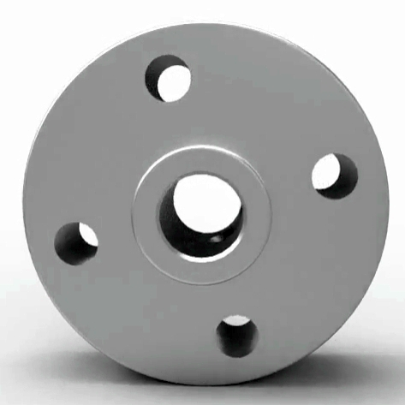
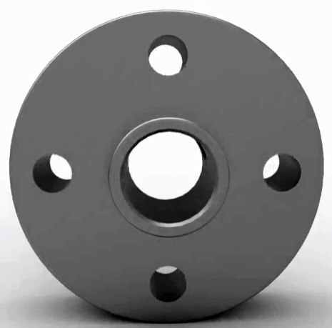
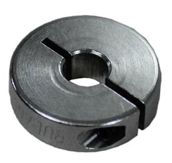
Chassis and Structural
Short Channels not L-Brackets
Flat Metal great for connecting channels
Center of Gravity Low
Axle Hub vs Motor Hub vs Collar Clamp
Axle Hub
Motor Hub
Collar Clamp

Slide 18
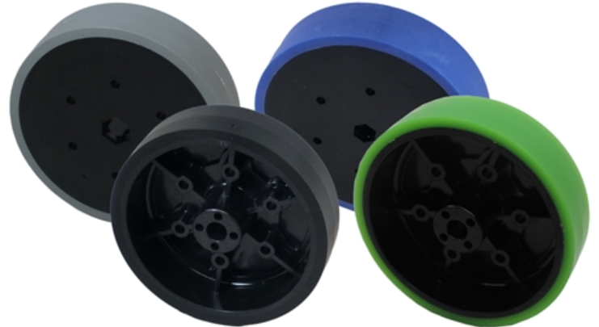
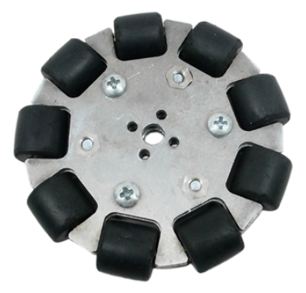
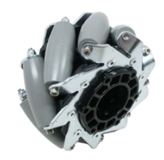
Types of Wheels
Stealth
Great for traction/torque
Heavy duty
Tank drive – good driver
Omni
Maneuverable
Light/small
Bad for traction
Mecanum
Maneuverable
Traction okay not great
Torque is good
Notes:
Andymark http://www.andymark.com/default.asp

Slide 19
Miscellaneous Building Tips
Make mini goals
Keep Improving Robot All Season
Test Each Element – Don’t Wait
Draw Sketches – label, date
Do Notebook Every meeting (don’t get behind)
Neverest Motors over Tetrix Motors
2-3 Batteries – 1 robot, 1 charging, 1 spare
1 or 2 Extra Phones

Slide 20
Building Video Tips
REV Resources
Hardware Tutorials from FIRST
Tetrix PushBot
REV PushBot

Slide 21
Electrical Tips
Electronic Videos from FIRST
Label Wires – label maker
Spare Fuses
Power/Kill Switch Accessible
Use proper gauge wire
FTC Wiring Guide

Slide 22
Battery Tips
Mark Batteries/Phones/Controllers with Team Number and Date Of Purchase
Use Rubber Bands to Mark Batteries that are Charged vs. Not Charged
Batteries keep at 14.0 V
Swap Batteries after each Match
Test Batteries with multimeter

Slide 23
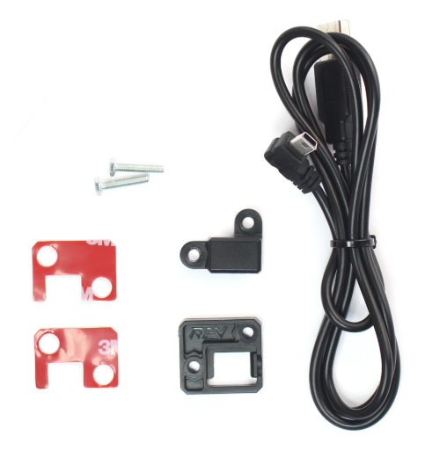
Prevent Disconnects
New USB Retention Mount $10
http://www.revrobotics.com/rev-41-1214/

Slide 24
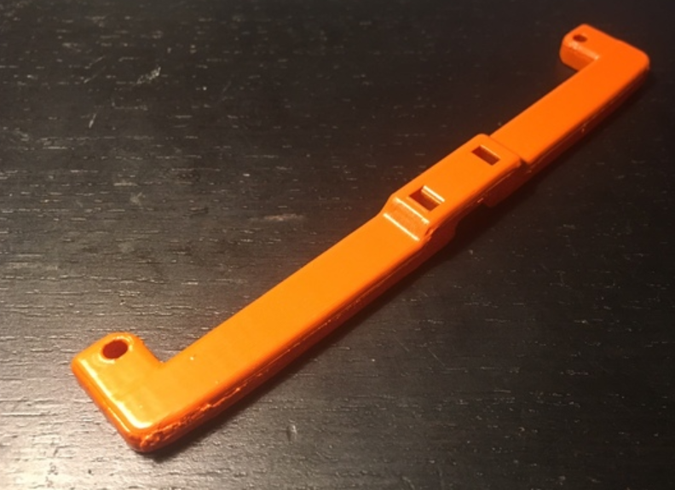
Stress Relief!
Stress Relief 3D Parts
Design Your Own
Thingiverse

Slide 25
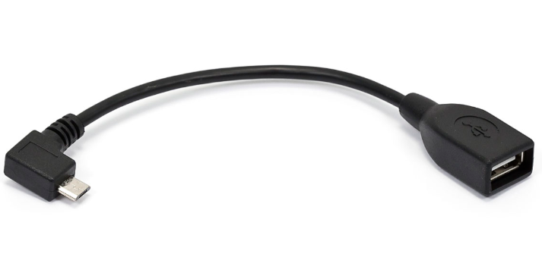
OTG Cable
MonoPrice OTG
Notes:
An OTG cable/adapter is what enables the control system smartphones (Robot Controller and Driver Station) to communicate with the REV Expansion Hub and the gamepads. Our experience has been that the USB micro-B connection at the phone interface is by far the weakest link in the control system; a loose or poor connection here can result in your robot being inoperable for most of a match. There are lots of OTG cables available on the market, and there are lots of bad OTG cables on the market -- even from vendors that tout the quality of their cables/connectors. Some cables are obviously bad as soon as you attach them (i.e., they're loose in the phone USB jack or even fall out entirely when you shake them), others will degrade over time such that they appear to work but in fact have only intermittent connections. Some teams try hot-gluing or otherwise securing OTG cables to the phone case to provide strain relief; in practice the problem is often pin deformation inside the connectors rather than the stability of the mounting. The Monoprice OTG cables listed here have been recommended by the FTC engineers and have generally worked well and held up over time. It's worth having a spare set of these cables handy in case the ones you're using start to fail.

Slide 26
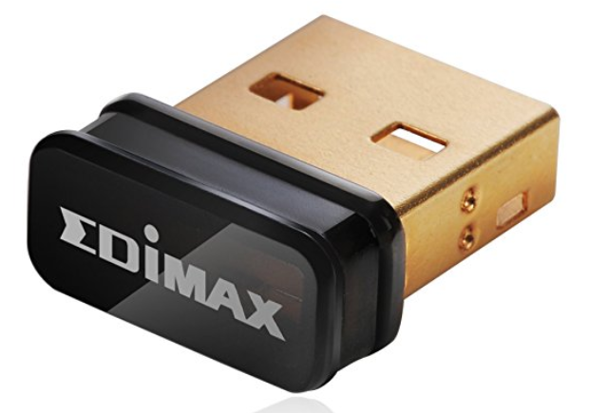
USB WiFi dongle
Adapters provide computers with an additional wireless port
Notes:
USB adapters provide computers with an additional wireless port to use to connect to the Robot Controller device, so that any existing wireless connection (e.g. to the Internet or a school network) remains available for use.

Slide 27
Programming Links and Tips
Document your programming
Use GitHub
Programming Resources from FIRST
Blocks Programming Tutorial
OnBot-Java-Tutorial
Java Beginning Tutorial Videos
STEM Robotics Java 201
Vuforia-VuMarks Tutorial

Slide 28
Help for FTC Teams
Schoology
Request for FTC Curriculum
FTC Reddit
FTC Forum
Facebook – FIRST Tech Challenge
Facebook – FTC Share and Learn

Slide 29
Connecting with Teams
Facebook Account
Twitter Account
FTCTEC NETWORK
Discord
FTC Channel

Slide 30
Links/Discounts
Servocity – FIRST – 25%, free part
Actobotics Freebies Twitter
@Actobotics
Actobotics Giveaways
Modern Robotics
Tetrix
8020.net – 40%
REV Discount - $25

Slide 31

Credits
This lesson was written by Patti Poston for FTCTutorials.com
More lessons for FIRST Tech Challenge are available at www.FTCtutorials.com
This work is licensed under a
Creative Commons Attribution-NonCommercial-ShareAlike 4.0 International License.

